Slide 1
Vector Stores
Complete Guide to Vector Storage in LangChain

Slide 2
Why Vector Stores? - Movie Database Example
Movie Metadata Table
Movie ID
Movie Name
Director
Actor
Genre
Release Date
M001
3 Idiots
Raju Hirani
Aamir Khan
Drama, Romance
2009
M002
Chennai Express
Rohit Shetty
Shah Rukh Khan
Romance, Comedy
2014
M003
Inception
C Nolan
L DiCaprio
Thriller, Sci-Fi
2009
M004
Stree
Amar Kaushik
Rajkummar Rao
Horror, Comedy
2019
Vector Concept:
Each movie can be converted into a numerical vector using embeddings. Vector stores then organize these vectors in a multi-dimensional space, enabling fast similarity searches. For example, searching for movies similar to 'Inception' would find movies with similar genres, themes, and metadata.

Slide 3
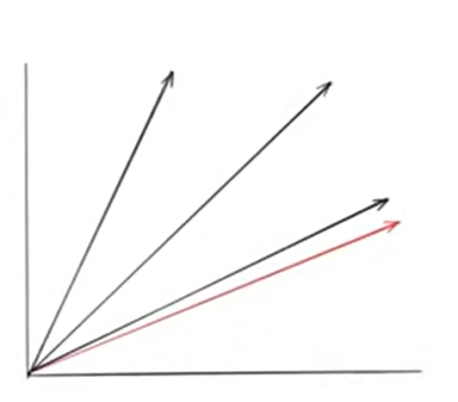
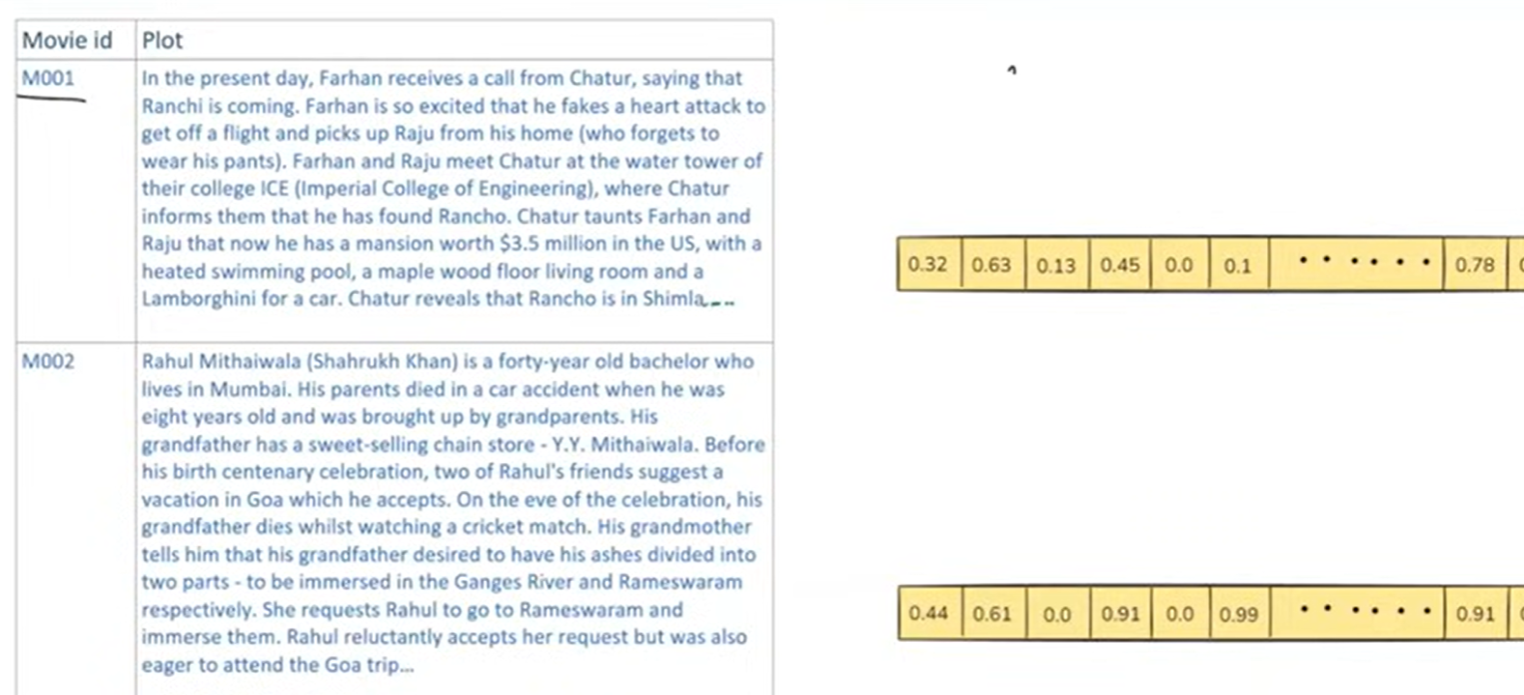

Slide 4
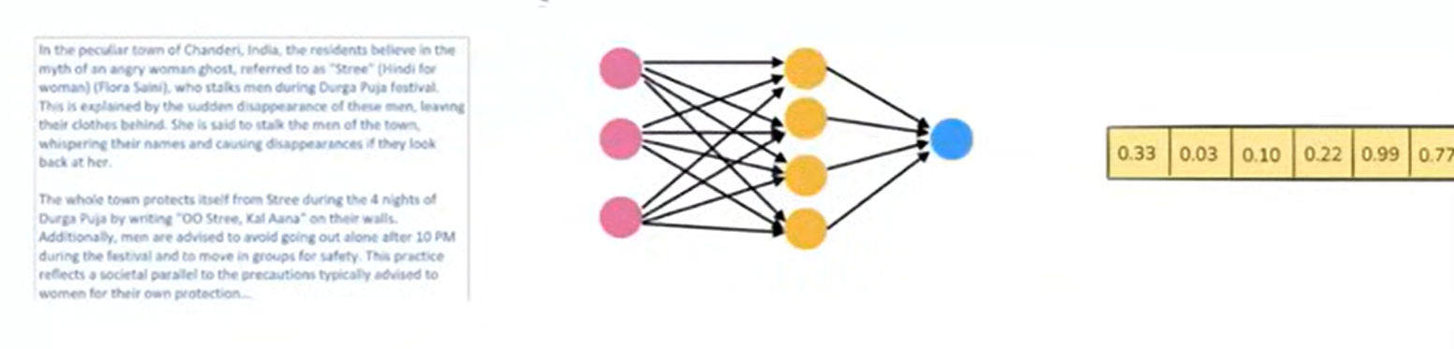

Slide 5
Challenges & Solution
Generate Embedding Vectors
Storage
Semantic Search – Intelligent Semantic Search
Solution
  Vector Store

Slide 6
Vector Representation - Movie Plots as Embeddings
3 Idiots
A drama about three engineering students and their pursuit of knowledge and friendship.
Genre: Drama, Romance
Embedding Vector: [0.92, 0.83, 0.54, 0.88, 0.91, ...]
Inception
A sci-fi thriller about corporate espionage and dream infiltration technology.
Genre: Thriller, Sci-Fi
Embedding Vector: [0.87, 0.45, 0.92, 0.51, 0.88, ...]
Stree
A horror-comedy about a ghostly woman who haunts men in a small town.
Genre: Horror, Comedy
Embedding Vector: [0.76, 0.68, 0.62, 0.84, 0.55, ...]

Slide 7
What is a Vector Store?
A vector store is a system designed to store and retrieve data represented as numerical vectors.
Storage
Ensures that vectors and their associated metadata are retained, whether in memory for quick lookups or on-disk for durability and large-scale use.
Similarity Search
Helps retrieve the vectors most similar to a query vector
Indexing
Provide a data structure or method that enables fast similarity searcheson high-dimensional vectors (e.g., approximate nearest neighbor lookups).
CRUD Operations
Manage the lifecycle of data—adding new vectors, reading them, updating existing entries, removing outdated vectors.

Slide 8
Vector Store Use Cases
🔍
Semantic Search
Find documents based on meaning, not just keywords
🔄
RAG (Retrieval-Augmented Generation)
Retrieve relevant context to improve LLM responses
⭐
Recommender Systems
Suggest similar products, content, or users
🖼️
Image/Multimedia Search
Find similar images or multimedia based on embeddings

Slide 9
Vector Store vs Vector Database
Vector Store
Vector Database
• Storage & Retrivers, Lightweight library or service
• Full-fledged database system
• Focuses on storing embeddings & similarity search
• Advanced database features : nearly ACID, authentication / Authorization, Durability & Persistence, Distributed architecture
• May not include many traditional database features like transactions, rich query languages, or role-based access control
• Distributed & scalable
• Production-ready
• Ideal for prototyping
• Examples: Milvus, Qdrant, Weaviate, Pinecone
• Example: FAISS (where you store vectors and can query them by similarity, but you handle persistence and scaling separately)
A vector database is effectively a vector store with extra database features (clustering, scaling, security, metadata filtering, and durability)

Slide 10
Vector Stores in LangChain
🔗 Multiple Integrations
from_documents()
add_documents()
simiarlity_search(query,k=2)
metadata-Based Filtering
FAISS, Pinecone, Chroma, Qdrant, Weaviate, and many more
🔄 Common Interface
Uniform API allows swapping backends with minimal code changes
📝 Metadata Handling
Attach metadata (timestamps, authors, tags) to each document

Slide 11
Chroma Vector Store
Chroma is a lightweight, open-source vector database that is especially friendly for local development and small- to medium-scale production needs.
Chroma Hierarchy
Key Features:
✓ Open-source and lightweight
User/Tenant
✓ Perfect for development environments
↓
Database
✓ Multi-tenant support with hierarchical organization
↓
Collections
↓
Documents
Tenant: User workspace
Database: Isolated data store
Collection: Related data group
Doc: Individual record

Slide 12
Key Takeaways
1. Vector stores enable efficient storage and retrieval of vector embeddings from various data sources
2. Convert data (text, images, metadata) into vectors for semantic similarity searches
3. Vector stores are lightweight; vector databases offer enterprise-grade scalability
4. LangChain provides unified interfaces to multiple vector store backends
5. Choose based on your needs: Vector stores for development, databases for production

